Slide 1
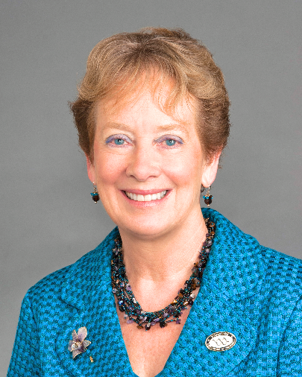
2021-22
Annual Women in Surgery Visiting Lectureship
Sponsored by the Loyola Women in Surgery Group
Department of Surgery - Grand Rounds
Wednesday, October 6, 2021 ● 7am - 8am
Julie A. Freischlag, MD, FACS, FRCSEd(Hon), DFSVS
Wake Forest Baptist Health, Chief Executive Officer
Wake Forest School of Medicine, Dean
Atrium Health Enterprise, Chief Academic Officer
Clinical and Personal
Comparative Effectiveness
Notes:
4th annual Loyola Women in Surgery visiting lectureship

